Slide 1
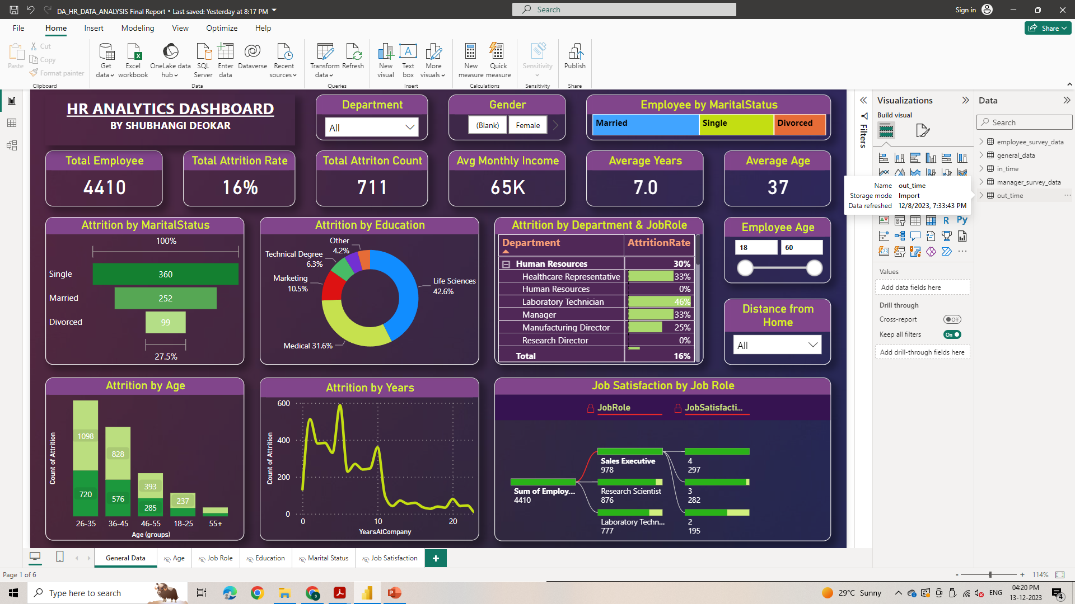

Slide 2
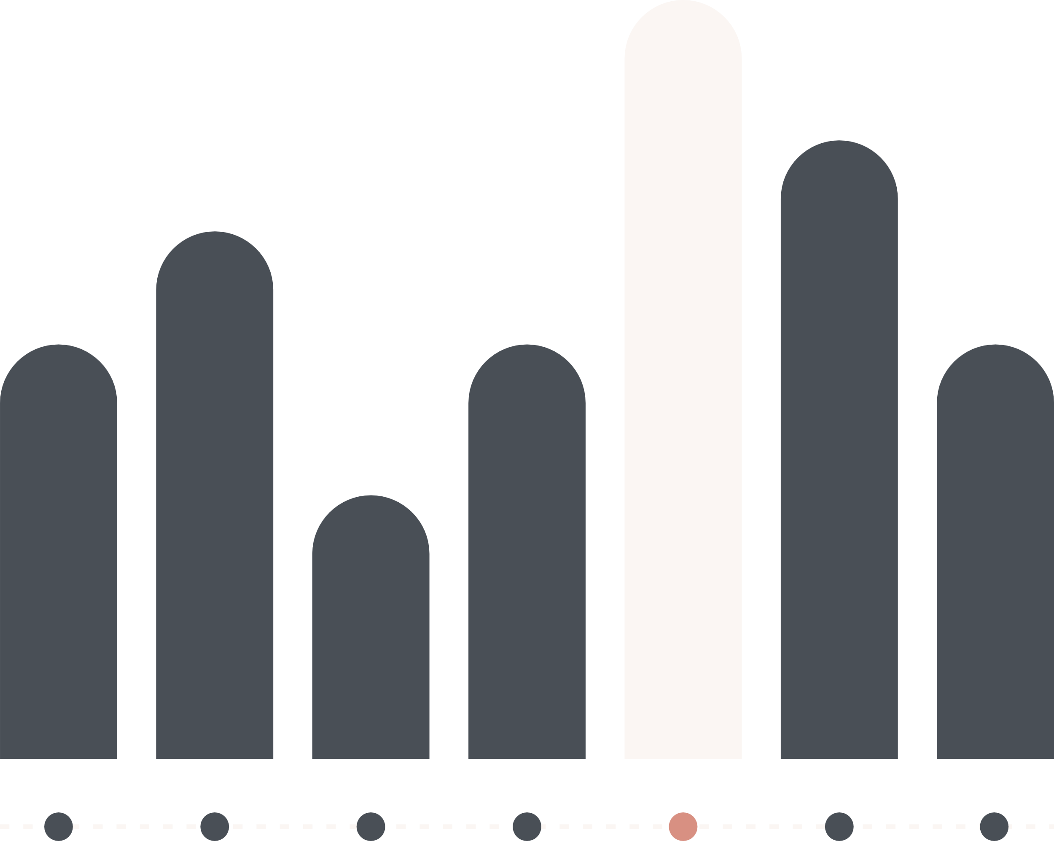

PSYLIQ - Data Science Intern (Task One)
HR DATA ANALYSIS
By Shubhangi Deokar

Slide 3
AGENDA
Dashboard
2) Project Aim, Objective
3) Data Exploration, Data Cleaning
4) Assessment Questions & Answers with Analysis
5) Summary

Slide 4

Project Aim :
The primary aim of this project is to explore and comprehend the factors contributing to employee attrition. By leveraging statistical analysis and data visualization techniques, the project aims to uncover patterns and trends related to attrition rates across different demographics, departments, and professional backgrounds.
Project Objective :
The objective of the project is to dissect various aspects of the provided data to gain insights into why attrition rates might be high, especially in certain demographics or departments.
The aim is to provide a comprehensive understanding that can lead to actionable strategies aimed at reducing attrition and enhancing employee retention.

Slide 5
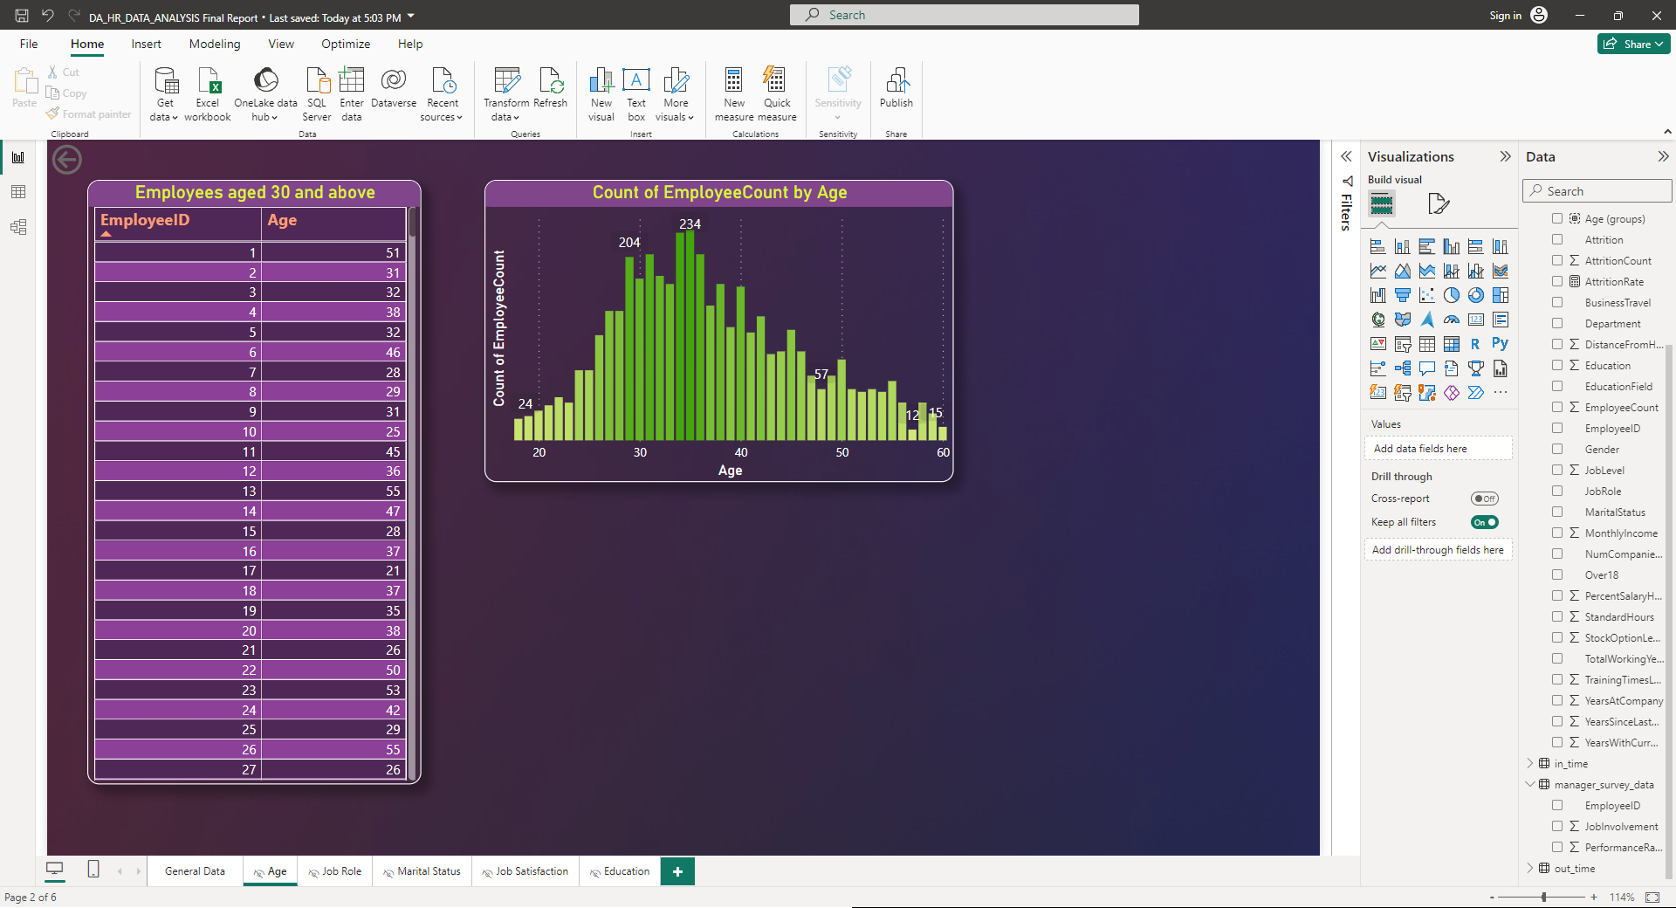
1. How would you filter the dataset to only show employees aged 30 and above?
In Power BI we can achieve this by using table visualization on columns Employee ID and Age. It appears that there are 3432 employees aged 30 and above.

Slide 6
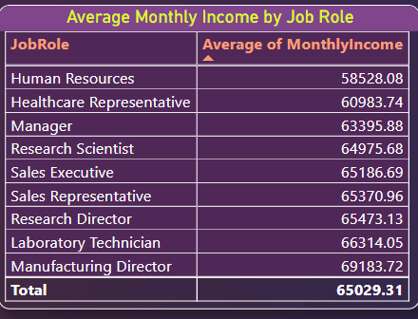
2. Summarize the average Monthly Income by Job Role.
In Power BI we can achieve this by using table visualization on columns Employee ID and Age. It appears that there are 3432 employees aged 30 and above.

Slide 7
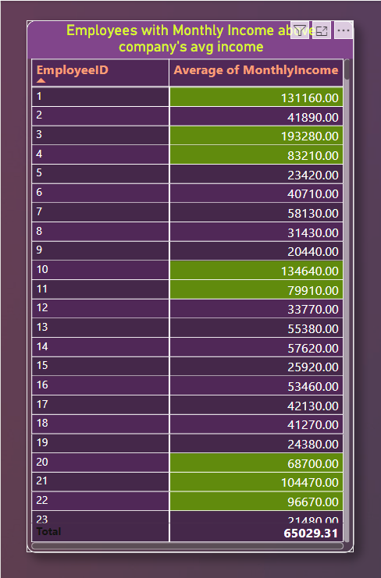
3. Apply conditional formatting to highlight employees with Monthly Income above the company's average income.
By applying conditional formatting we found that 1479 out of 4410 employees have Monthly Income above the company's average income which is 65029.

Slide 8
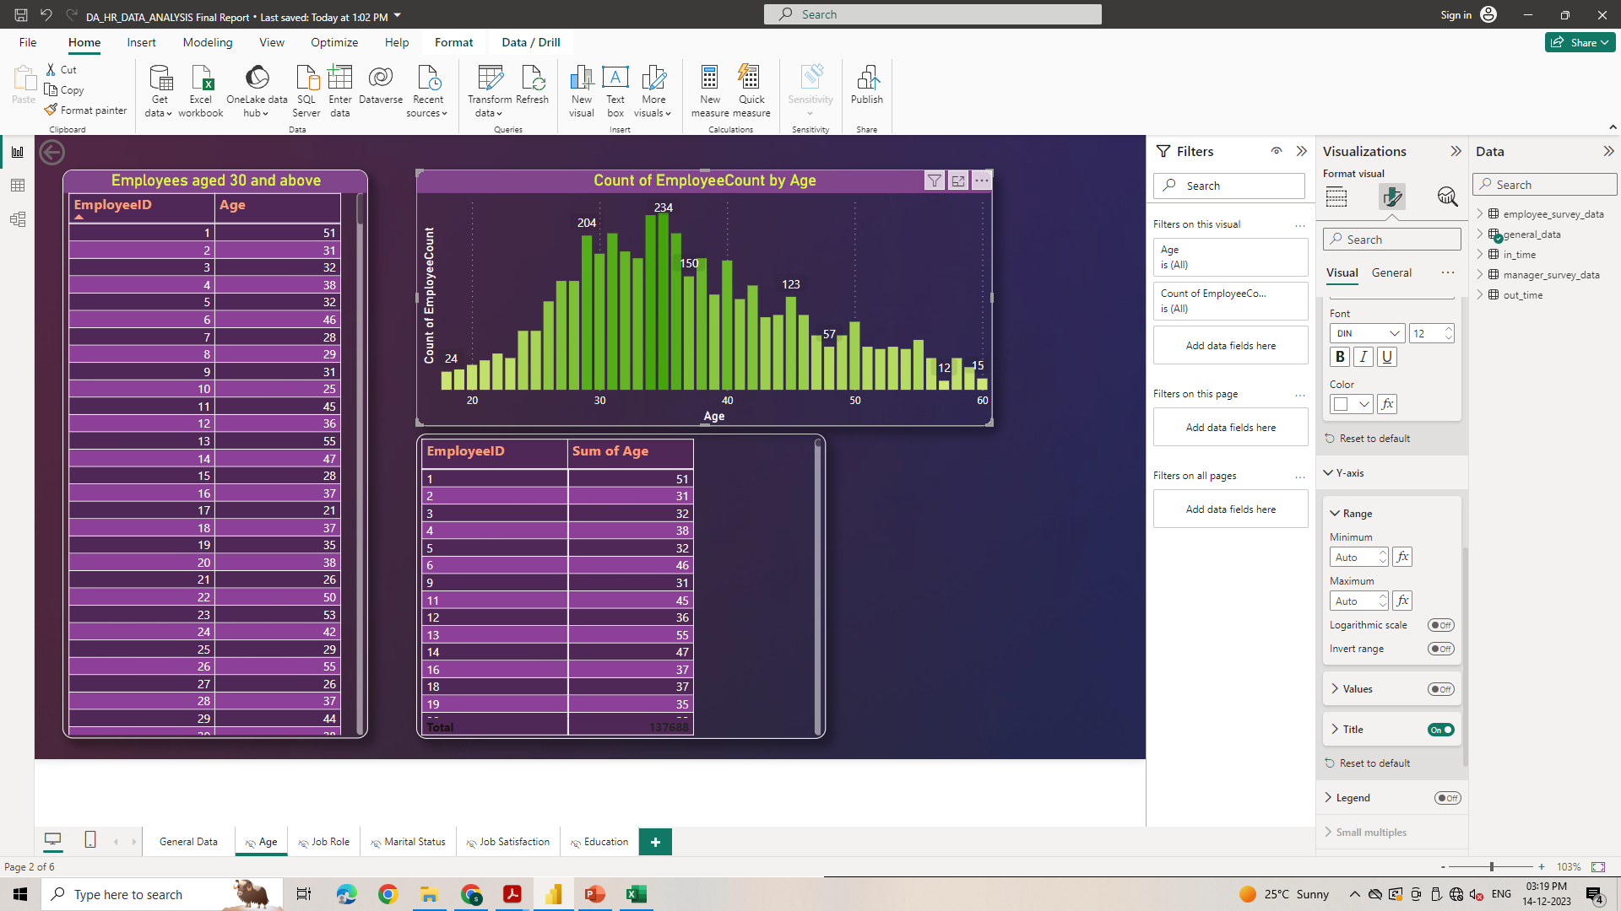
4. Create a bar chart to visualize the distribution of employee ages.
With bar chart it is clear that highest number of employees that is 234 are of age 35 and the lowest age group is 57 with 12 employees.

Slide 9
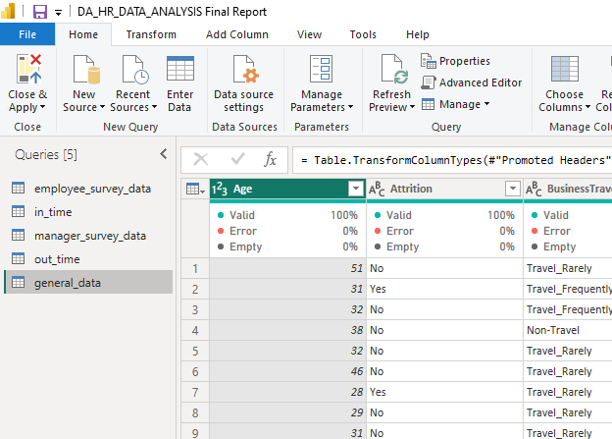
5. Identify and clean any missing or inconsistent data in the "Department" column.
No cleaning is needed for the 'Department' column as it contains no missing or inconsistent values as shown in screenshot.

Slide 10
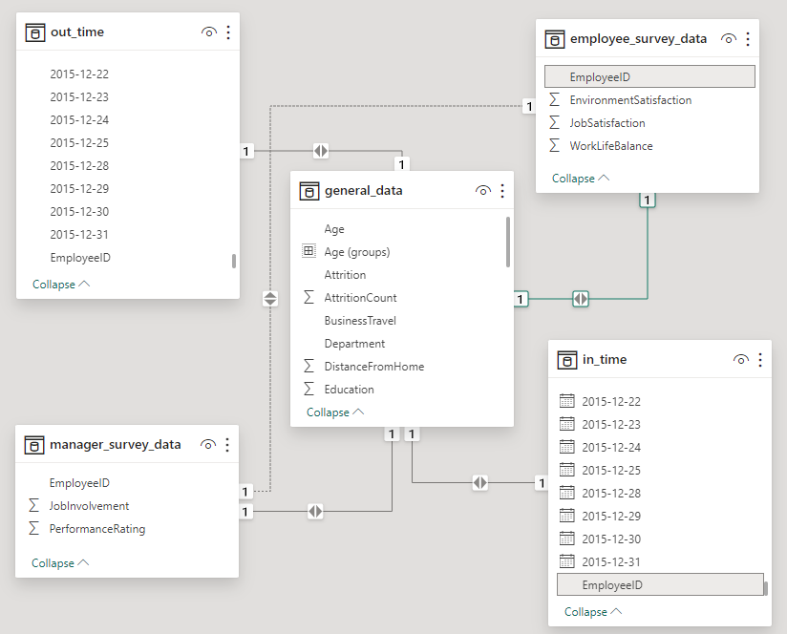
6. In Power BI, establish a relationship between the "EmployeeID" in the employee data and the "EmployeeID" in the time tracking data.
We have to apply some transformations to connect general data to in_time and out_time like adding headers, renaming header to establish a relationship between the "EmployeeID" in the employee data and time tracking data.

Slide 11
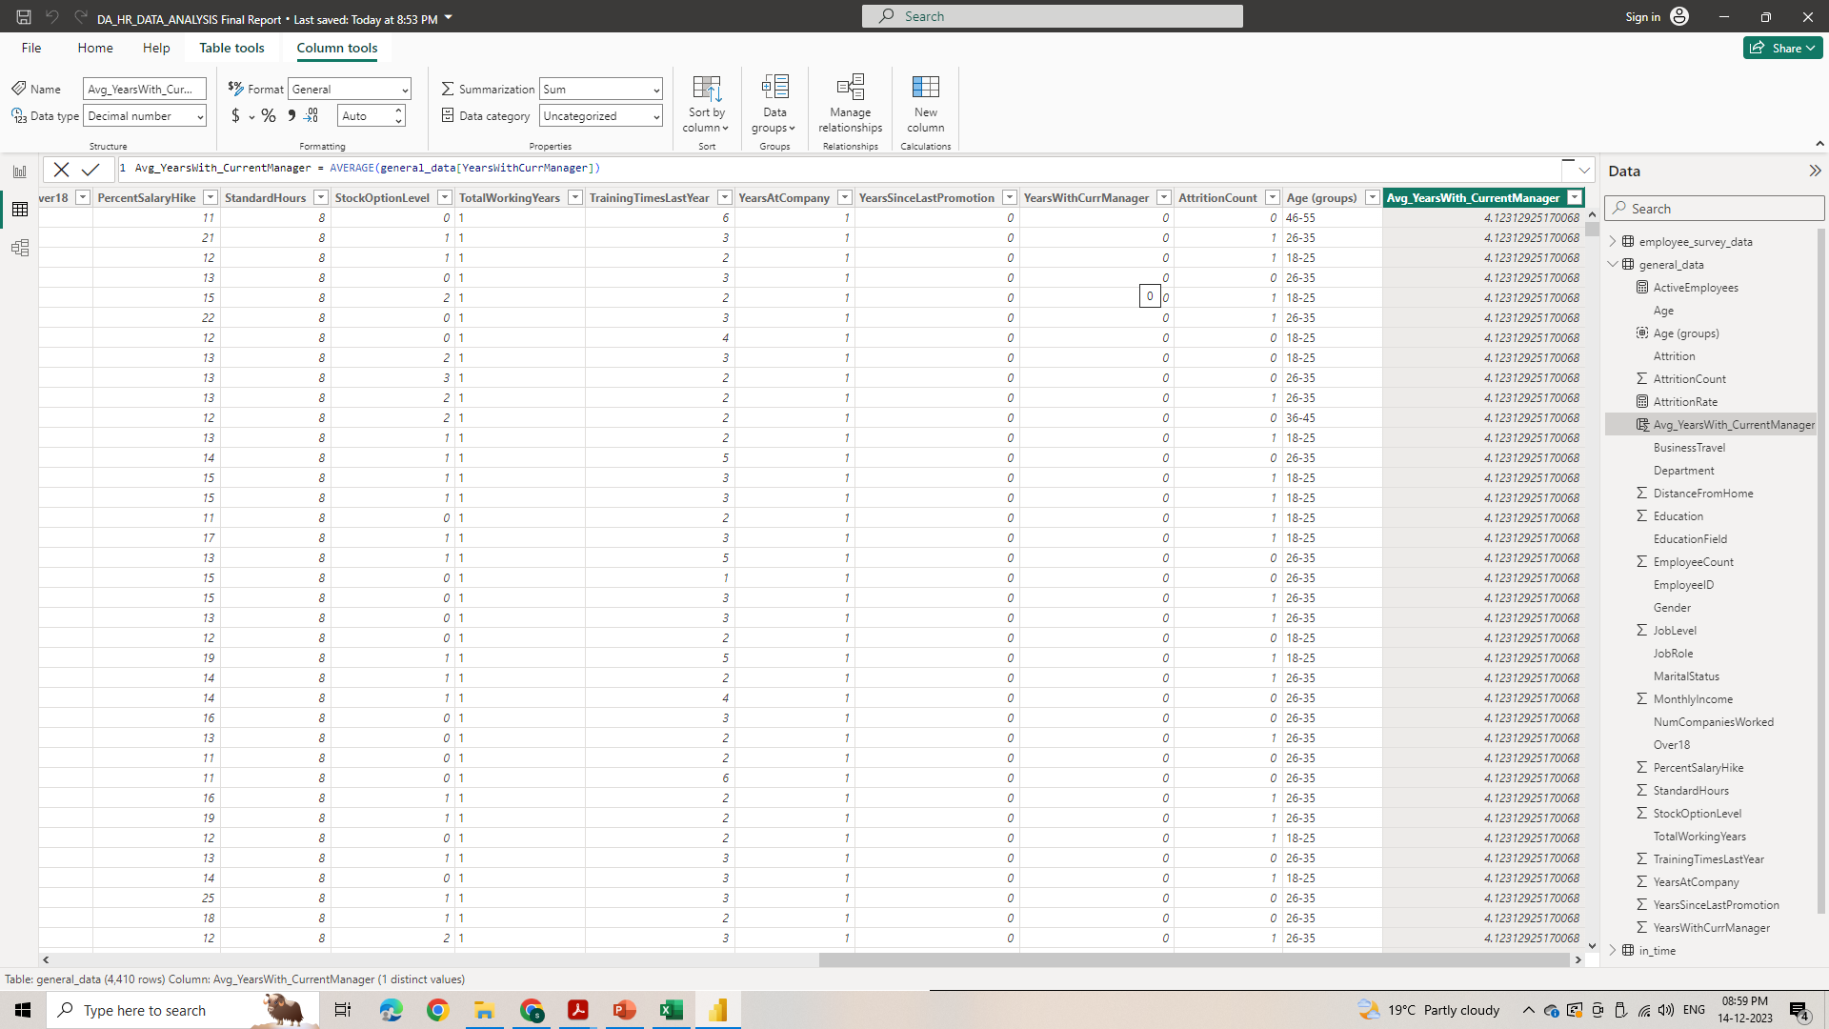
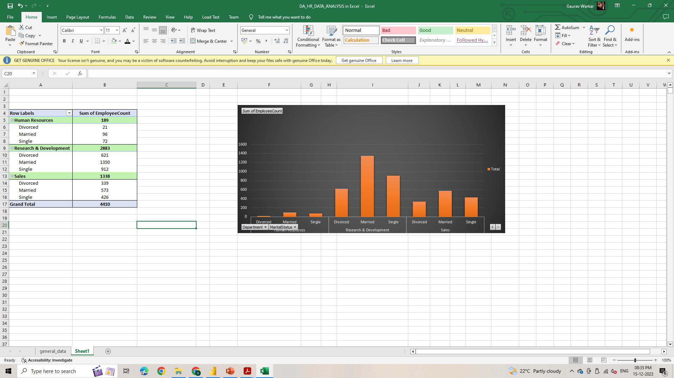
7. Using DAX, create a calculated column that calculates the average years an employee has spent with their current manager.
According to this DAX formula average years an employee has spent with their current manager is 4.12.
8. Using Excel, create a pivot table that displays the count of employees in each Marital Status category, segmented by Department.
It is clear from pivot table that number of married employees is more in each department.

Slide 12
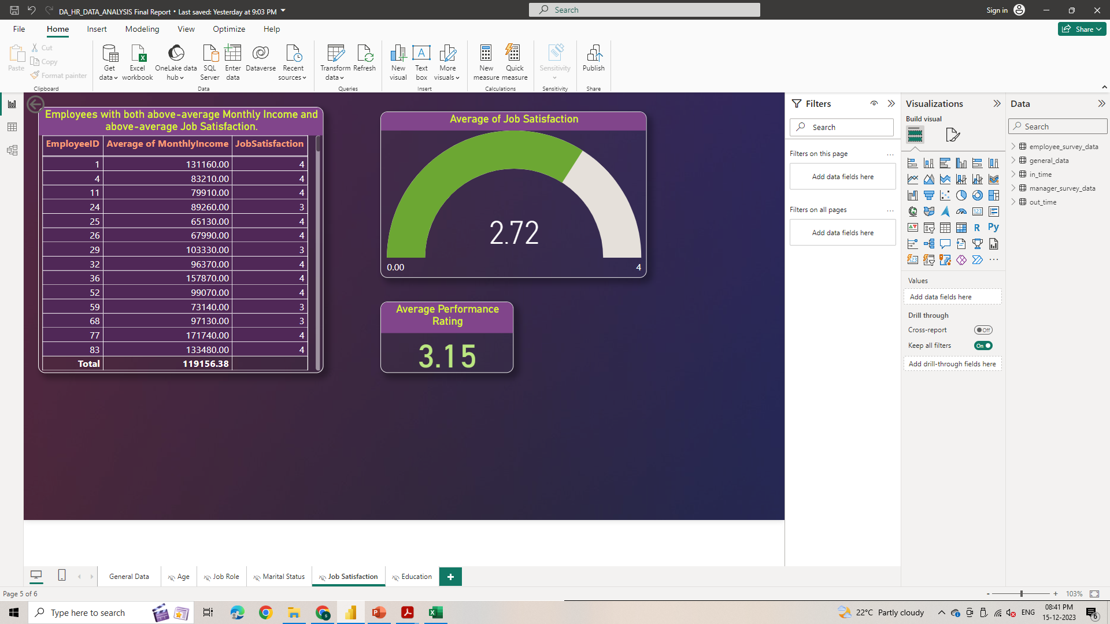
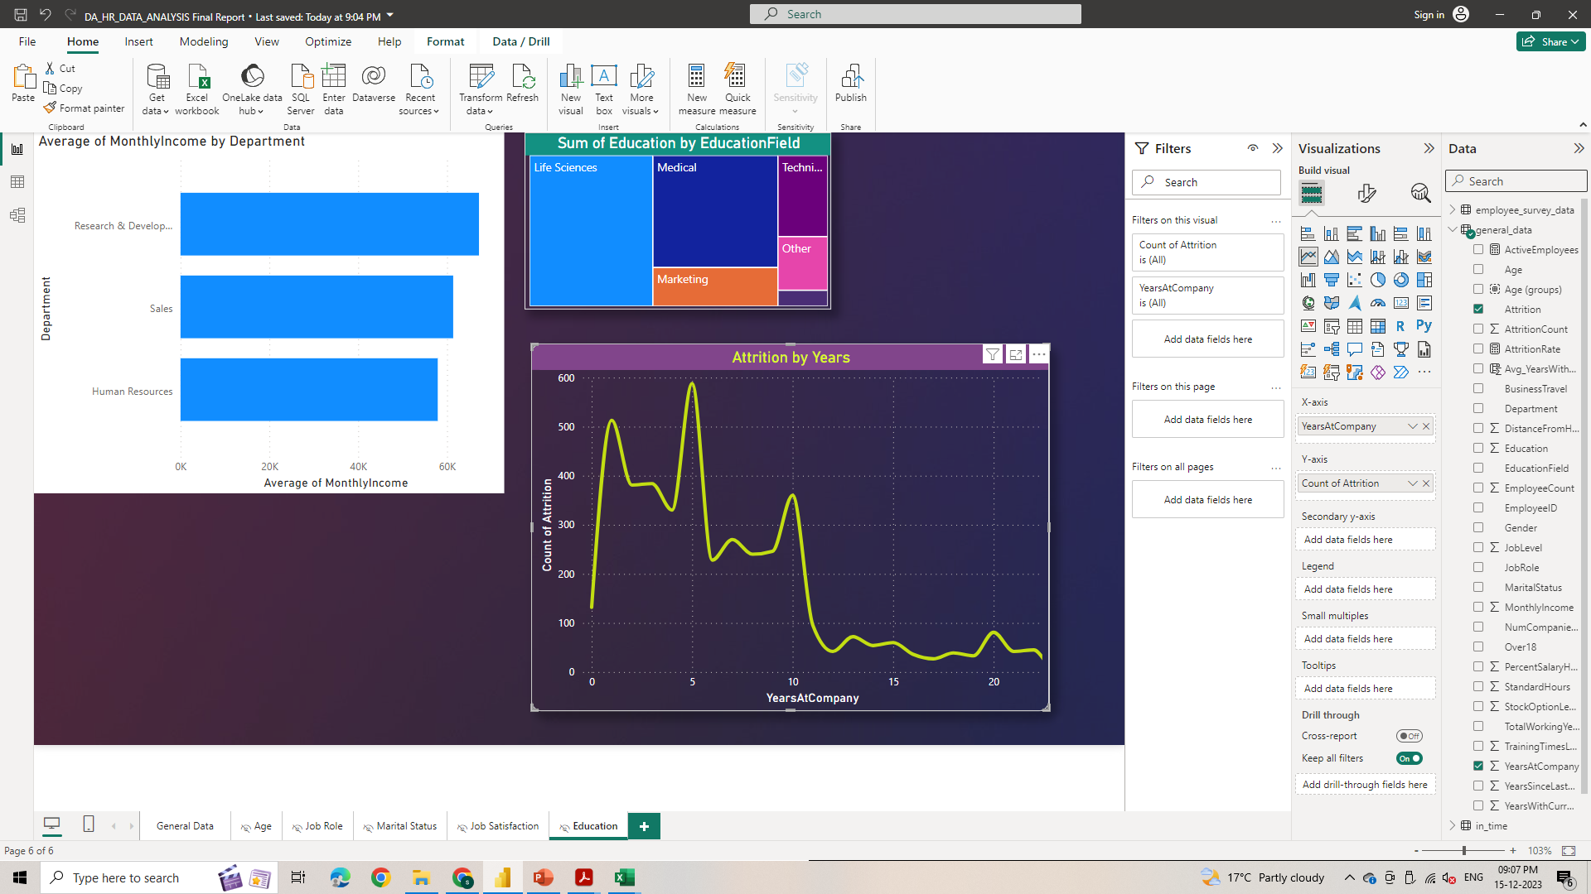
9. Apply conditional formatting to highlight employees with both above-average Monthly Income and above-average Job Satisfaction.
In Power Bi after applying both this filter it is clear that 931 employees have above-average Monthly Income and above-average Job Satisfaction.
10. In Power BI, create a line chart that visualizes trend of Employee Attrition over the years.
We noticed that maximum employee left company in first 10 years.

Slide 13
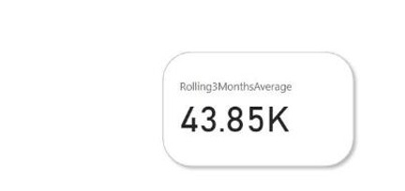
11. Describe how you would create a star schema for this dataset, explaining the benefits of doing so.
Creating a star schema involves structuring data into a central fact table like 'MonthlyIncome', 'DistanceFromHome', 'TotalWorkingYears', 'YearsAtCompany' surrounded by dimension tables like ‘Age’, ‘JobRole', 'JobLevel', 'JobInvolvement', 'JobSatisfaction', 'BusinessTravel’ optimizing data storage, query performance, and ease of analysis.
BENEFITS OF USING A STAR SCHEMA:
By structuring the dataset into a star schema, you promote efficient querying, ease of analysis, and a scalable framework that aligns well with business intelligence and reporting needs.
12. Using DAX, calculate the rolling 3-month average of Monthly Income for each employee.

Slide 14
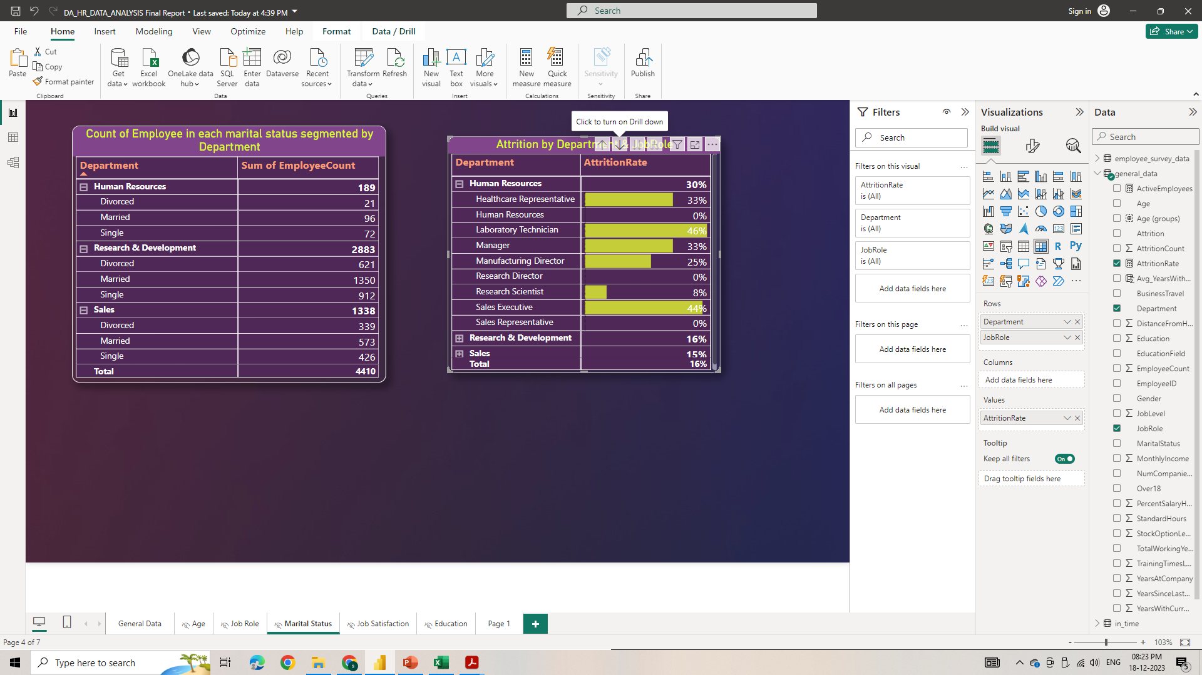
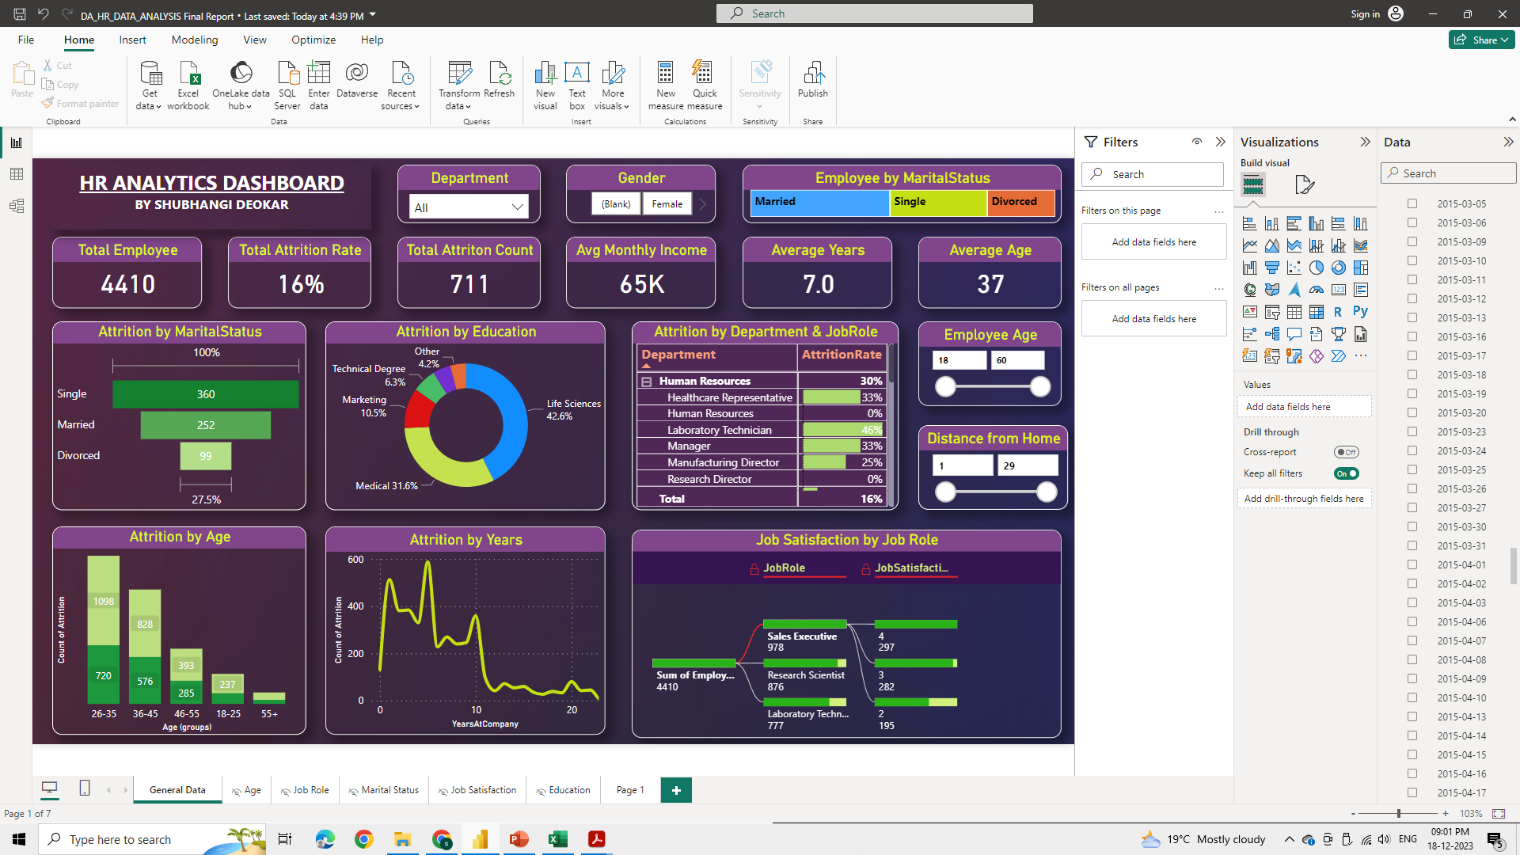
13. Create a hierarchy in Power BI that allows users to drill down from Department to Job Role to further narrow their analysis.
By using down arrow we can drill down from Department to Job Role.
14. How can you set up parameterized queries in Power BI to allow users to filter data based
on the Distance from Home column?
1. Select Home > Transform data > Transform data to open the Power Query Editor.
2. In the Power Query Editor, select New Parameters under Manage Parameters in the ribbon.
3. In the Manage Parameters window, fill out the information about the parameter. 4. By this we have created slicer for Distance from Home column

Slide 15
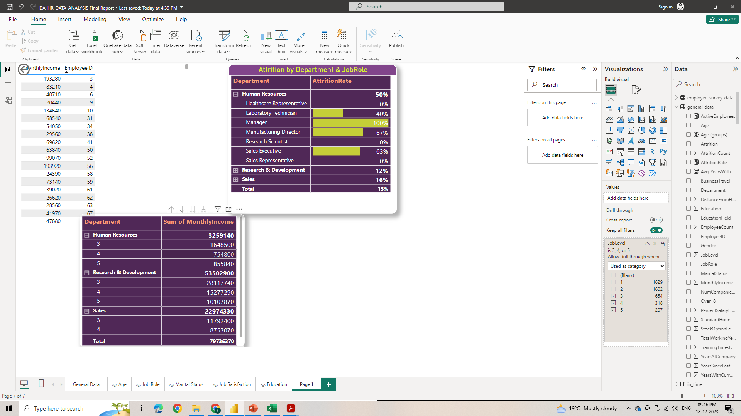
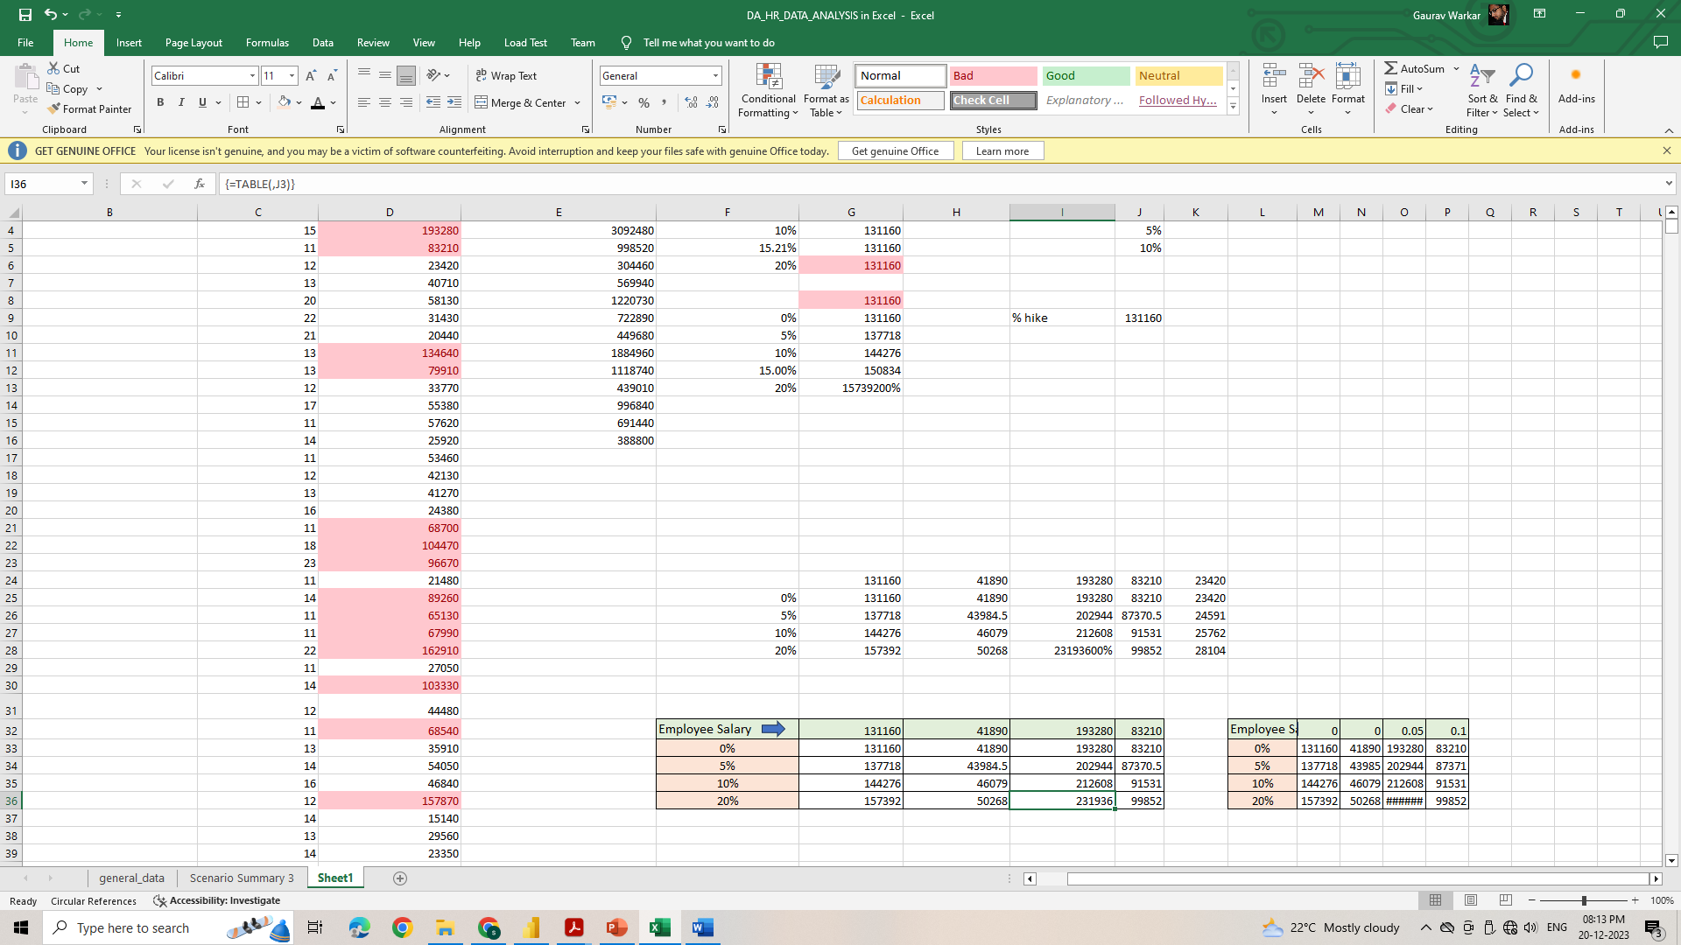
15. In Excel, calculate the total Monthly Income for each Department, considering only the employees with a Job Level greater than or equal to 3.
16. Explain how to perform a What-If analysis in Excel to understand the impact of a 10% increase in Percent Salary Hike on Monthly Income.

Slide 16
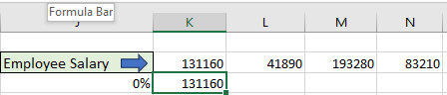
First we will use formula to calculate % hike of employee salary = emp salary*(1+percent hike)
Create a table with salaries in row by using above formula % cell reference like K2*(1+J3) where K2= emp salary cell, J3=%hike & % hike in columns.( As shown in below image)
Select this table -> In Excel go to data tab-> what if analysis-> Data table
In Column input cell put cell which has % reference (here J3 cell)
It will automatically calculate % hike of specific salary.
17. Verify if the data adheres to a predefined schema. What actions would you take if you find inconsistencies?
Verify that the data types of each column
Check for primary key and foreign key constraints if applicable.
Identify and manage for missing values & duplicate records.
Implement data cleansing and transformation.
Set up mechanisms for continuous monitoring of data quality.

Slide 17
Summary:
In Data ➔ 1= Bad 2 = Good 3 = Better 4=Best
Total Employees are 4410 in which 1764 – females & 2646 - male
Attrition count is 711 i.e. 16%
Average monthly income is Rs. 65029
Average of percent salary hike is 15.21%
Average performance rating is 3.15/4
Average job satisfaction is 2.72/4
Maximum employees i.e. 65.37% working in Research & Development department.
Attrition rate is maximum for :
a) Employees belongs to 26-35 age group
b) Employees with life science educational background attrition rate is 42.6%
c) Employees working in Human Resource department which is 30%

Slide 18
Thank You !

